Slide 1



Question Answering over Curated and Open Web Sources Rishiraj Saha Roy Avishek Anand Max Planck Institute for Informatics, Germany L3S Research Center, Germany

Slide 2
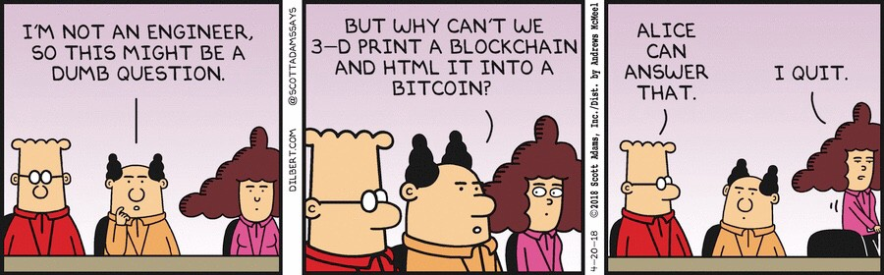
Question Answering is AI complete
To perfectly solve QA
Involves world-knowledge
Linguistics: co-ref, pragmatics, high-level reasoning tasks such as natural language inference
Common sense reasoning
Question Answering over Curated and Open Web Sources R. Saha Roy and A. Anand
Notes:
They are used as de-facto Turing test proxies: if a model can perform such reasoning, then we know that it does indeed capture a lot of language knowledge.

Slide 3
Question Answering is AI complete
Passage: Anita was stung by a bee and left the garden.
Question: Why did Anita leave the garden ?
Because she was in pain
Because it was time for a TV show she didn’t want to miss
Because its common practice to leave the garden after being stung by a bee
Because the bee needed some peace
Simple questions that are hard for the machine
Need Pragmatics
Question Answering over Curated and Open Web Sources R. Saha Roy and A. Anand
Notes:
They are used as de-facto Turing test proxies: if a model can perform such reasoning, then we know that it does indeed capture a lot of language knowledge.

Slide 4

Question Answering is AI complete
Notes:
They are used as de-facto Turing test proxies: if a model can perform such reasoning, then we know that it does indeed capture a lot of language knowledge.

Slide 5
Question Answering is AI complete
In its full glory, it is indeed hard
But there has been a lot of progress
Knowledge-driven Question Answering
Reading comprehension
The AI in this sci-fi movie owed its intelligence to a massive cache of search engine data.
This movie has the plot adapted from this famous play..and has 3 of its main characters named after all biblical characters
— Eve, Nathan and Caleb
Notes:
And we wouldn’t be having this tutorial in the first place

Slide 6
Lots of Success
Search
Notes:
Search, dialogue, information extraction

Slide 7

Lots of Applications
Search
Problems in NLP, Dialog and Search can be formulated as QA
Question Answering over Curated and Open Web Sources R. Saha Roy and A. Anand
Notes:
Search, dialogue, information extraction, What is the sentiment of this review ?

Slide 8
In this part of the tutorial…
We focus on where progress has been made
What tasks are out there
Reading comprehension, Open-domain QA, Conversational QA
What models are usually used to solve them
Neural, neural, neural
Challenges and design decision
Question Answering over Curated and Open Web Sources R. Saha Roy and A. Anand
Notes:
They are used as de-facto Turing test proxies: if a model can perform such reasoning, then we know that it does indeed capture a lot of language knowledge.

Slide 9
What we do not cover
Approaches pre 2016
Other related QA tasks
MCQ
Visual QA
Complex QA requiring selection, aggregation …
Model details
We will miss many QA approaches and many QA tasks….
Question Answering over Curated and Open Web Sources R. Saha Roy and A. Anand
Notes:
They are used as de-facto Turing test proxies: if a model can perform such reasoning, then we know that it does indeed capture a lot of language knowledge.

Slide 10

Brief History of QA
60‘s – 90‘s
1999
2013
Shank et al
Murax et al.
Hirschmann
BASEBALL
Simmons et al.
TREC QA track
MCTest
LUNAR
NLP interfaces to databases
Precursors to the modern open-domain QA
Mostly structured knowledge and limited domain
Story Comprehension
Precursors to Modern RC tasks
Shank et al. (1977) – Yale AI Project
Hirschman (1999)
Question Answering over Curated and Open Web Sources R. Saha Roy and A. Anand
Notes:
They are used as de-facto Turing test proxies: if a model can perform such reasoning, then we know that it does indeed capture a lot of language knowledge.
Hirschman and Gaizaukas
Natural Language frontends
BASEBALL, LUNAR
Dailog interactive advisories
SHRDLU, GUS (Problems of anaphora and ellipsis)
QA and Story comprehension
Origins of modern MRC – Wendy Lehnert and the QUALM system

Slide 11
QA @ TREC
Goal
Encourage research in information retrieval based on large-scale collections
Types of Questions:
Fact-based, short answers
How many feet in a mile ?
Name a food high in zinc.
When was the first stamp issued ?
Definition questions
Who was Galileo ?
What is an atom ?
What is lymphosarcoma ?
Reformulation questions
What attracts tourists in Reims ?
What are tourist attractions in Reims ?
Question Answering over Curated and Open Web Sources R. Saha Roy and A. Anand
Notes:
They are used as de-facto Turing test proxies: if a model can perform such reasoning, then we know that it does indeed capture a lot of language knowledge.

Slide 12
Modern History of Text QA
CNN/Daily Mail
LAMBADA
ProcessBank
(500 questions)
WikiReading
NewsQA
HotpotQA
MCTest
(2600 Questions)
SQuAD
MsMarco
QUAC
Children Book Test
Who Did What ?
Started with CNN/Daily Mail and popularized with SQUAD
Benchmarks ranging from
Simple to complex questions
Realistic to synthetically generated questions
Crowdsourced to extractive answers
Question Answering over Curated and Open Web Sources R. Saha Roy and A. Anand
Notes:
They are used as de-facto Turing test proxies: if a model can perform such reasoning, then we know that it does indeed capture a lot of language knowledge.

Slide 13
SQUAD
Extractive answers, span extraction
> 100k examples
Deep learning wave
Question Answering over Curated and Open Web Sources R. Saha Roy and A. Anand
Notes:
They are used as de-facto Turing test proxies: if a model can perform such reasoning, then we know that it does indeed capture a lot of language knowledge.

Slide 14

SQUAD v1, v2
Question: Which team won Quiz Bowl 50 ?
Version 1
All answers in the context
Evaluation – Exact Match
Evaluation – F1
Partial match assuming BoW
Version 2
Open world assumption
1/3 training instances have no answer
½ dev/test instances have no answer
Question Answering over Curated and Open Web Sources R. Saha Roy and A. Anand
Notes:
F1 Is more realistic, takes into account partial matches, line breaks etc. F1 metric ignores articles like a, an, the
Systems can rank candidates and choose the best one.
SQUAD does encode genuine information needs. Neberthless, well-targeted, well-structured dataset

Slide 15

Cloze tests
CNN/Daily Mail
Question Answering over Curated and Open Web Sources R. Saha Roy and A. Anand

Slide 16
Span Extraction
SQuAD
Question Answering over Curated and Open Web Sources R. Saha Roy and A. Anand

Slide 17
Multiple Choice Answers
Question Answering over Curated and Open Web Sources R. Saha Roy and A. Anand

Slide 18
Free form Answers
Question Answering over Curated and Open Web Sources R. Saha Roy and A. Anand

Slide 19

Outline: QA over Text
Background: History, Tasks
Machine Comprehension: Neural models, attention
Open Domain QA: QA over a text corpus
Feedback and Interpretability
Conversational QA: Implicit context in multi-turn setup
Take-home: Summary and insights
Representative methods from each task
Families of algorithms to build up repertoire for text
Focus on methods (and not evaluation)
Design decisions and challenges
Question Answering over Curated and Open Web Sources R. Saha Roy and A. Anand
Notes:
Benchmarks and metrics, feedback? Talk about methods and not evaluation. Give you an idea on the families possible. Repertoire. How to go from question to answer.
Please don’t be annoyed if you are not mentioned.

